Slide 1
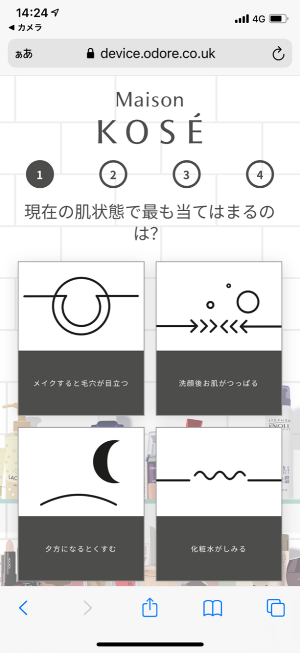

Step4 : Question #1
Can we make Japanese translations a little smaller with NO line breaks, as follows?
現在の肌状態で最も当てはまるのは？
現在の肌状態で最も当てはまるのは？

Slide 2
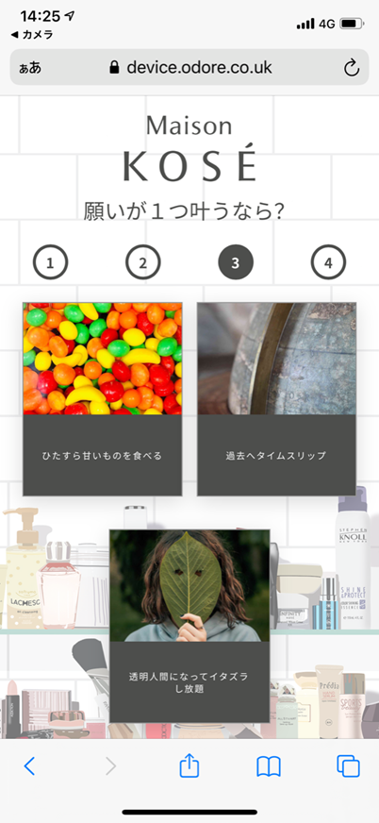
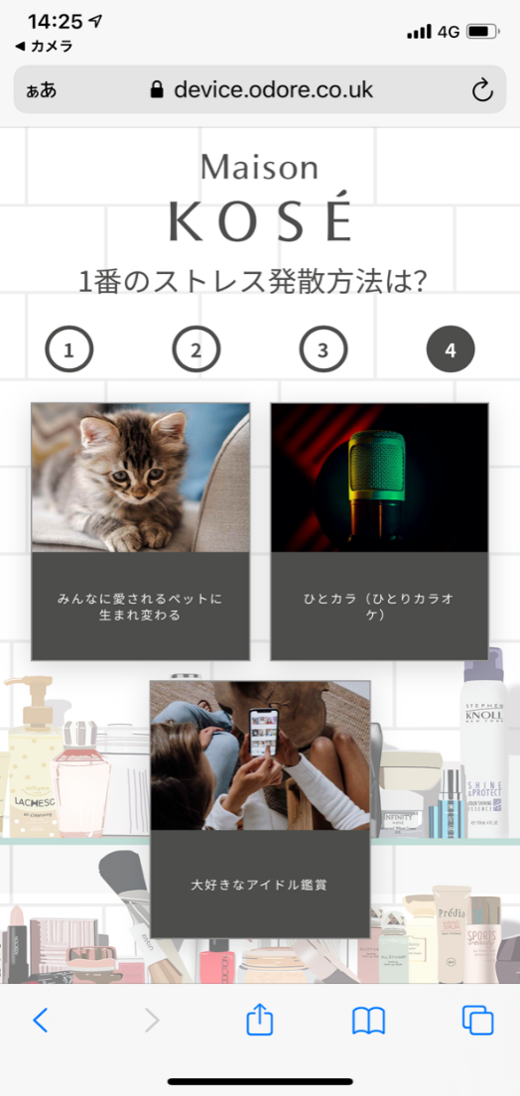
Step6 : Question #3
Currently, the answer from Question #4 is used.
Please revise the answer to the correct one as follows.

Slide 3
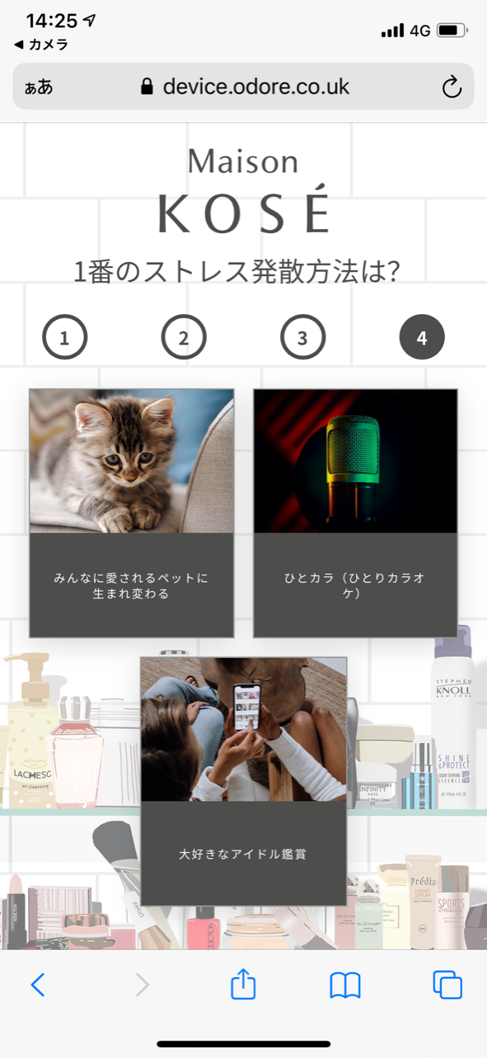

Step7 : Question #4
Currently, the answer from Question #3 is used.
Please revise the answer to the correct one as follows.

Slide 4
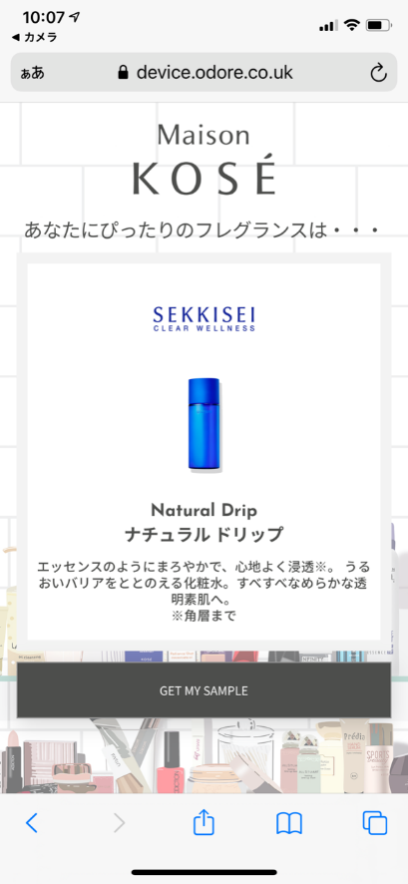
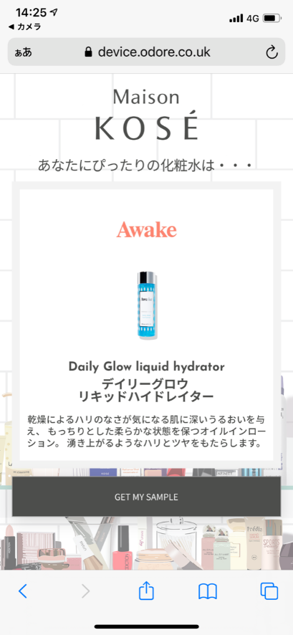
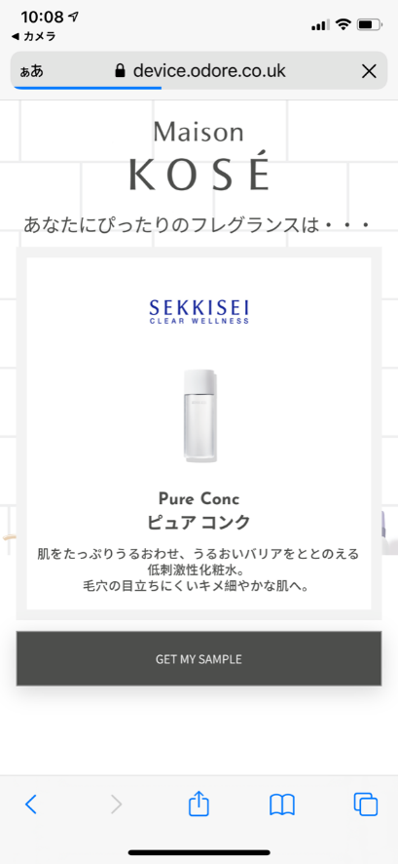
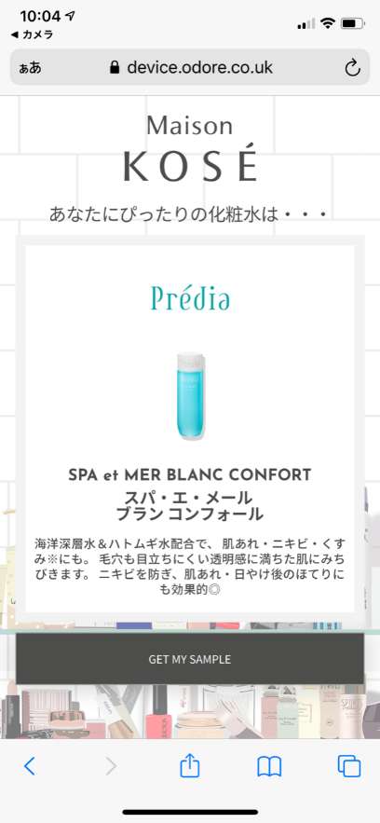
Step8 : Recommendation
Please revise Japanese translation of SEKKISEI pure conc and SEKKISEI natural drip with the following one;あなたにぴったりの化粧水は・・・
化粧水
化粧水

Slide 5
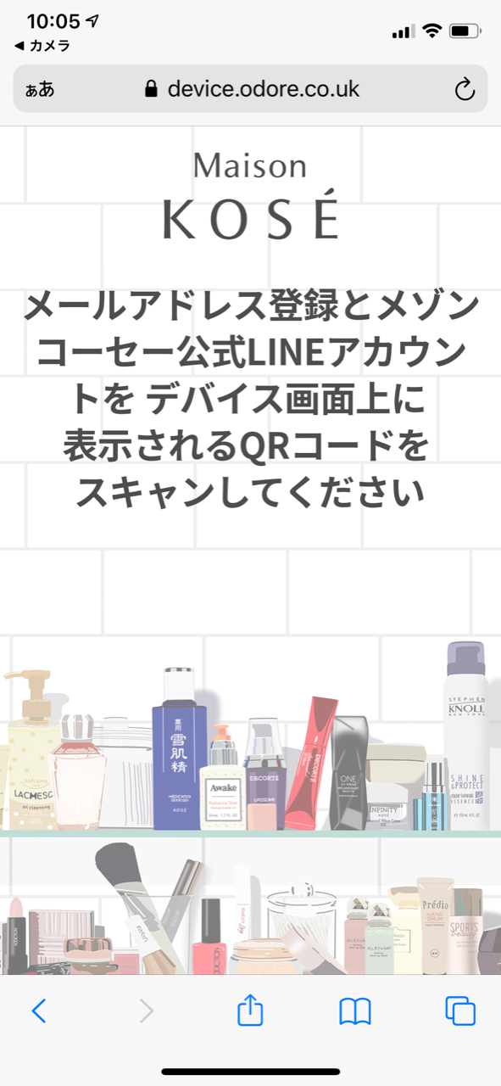

Step10 : Notificaton to scan QR code
Please replace Japanese translation with the following one;
デバイス画面上に
表示されるQRコードを
スキャンしてください
デバイス画面上に
表示されるQRコードを
スキャンしてください

